Slide 1
Genome-wide Association Studies for Stigma Exsertion in Tomato (Solanum Pimpinellifolium) Germplasm Collection
報告人：閻大瑞 （論文宣讀）
指導教授：陳凱儀 老師

Slide 2
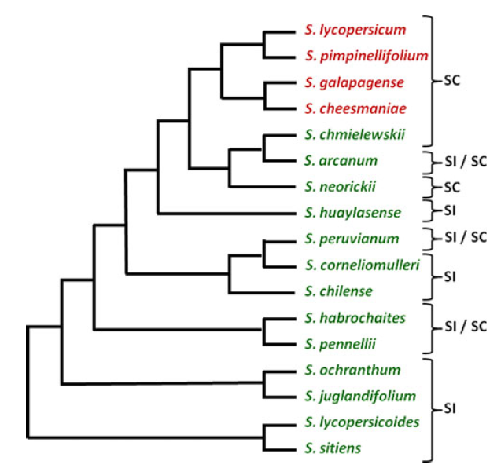
Tomato Clade
red / orange
fruits
S. pimpinellifolium :
exserted stigma
facultative mating system
Bedinger, P. A., Chetelat, R. T., McClure, B., Moyle, L. C., Rose, J. K., Stack, S. M., ... & Royer, S. (2011). Interspecific reproductive barriers in the tomato clade: opportunities to decipher mechanisms of reproductive isolation. Sexual Plant Reproduction, 24(3), 171-187.

Slide 3

Germplasm Collection
235 accessions of S. pimpinellifolium
Orignal from America including
Peru : 191
Equador : 19
Venezuela : 1
Central America : 19
North America : 4
South Asia : 1

Slide 4
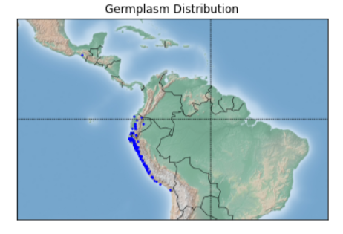
154 accessions

Slide 5
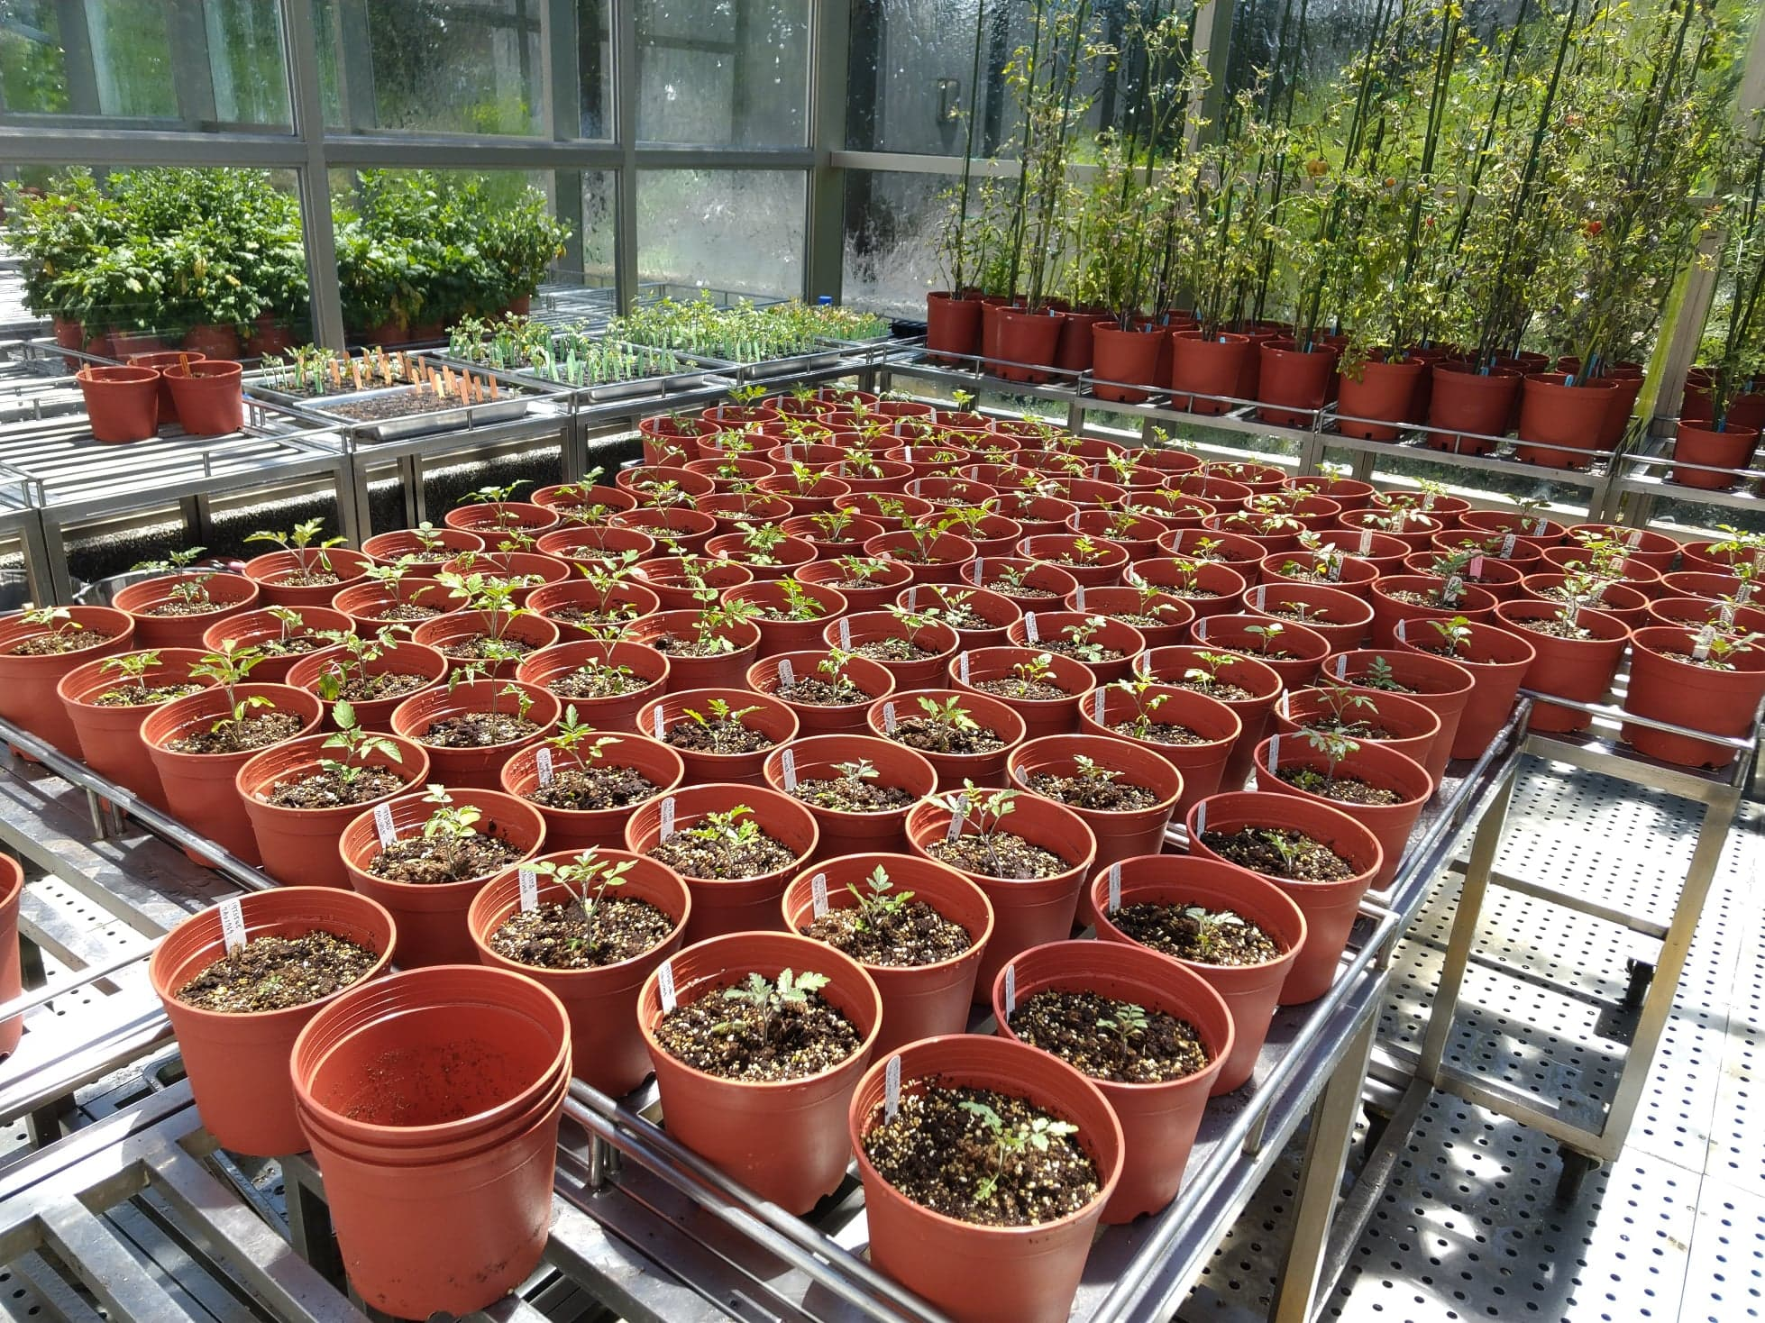
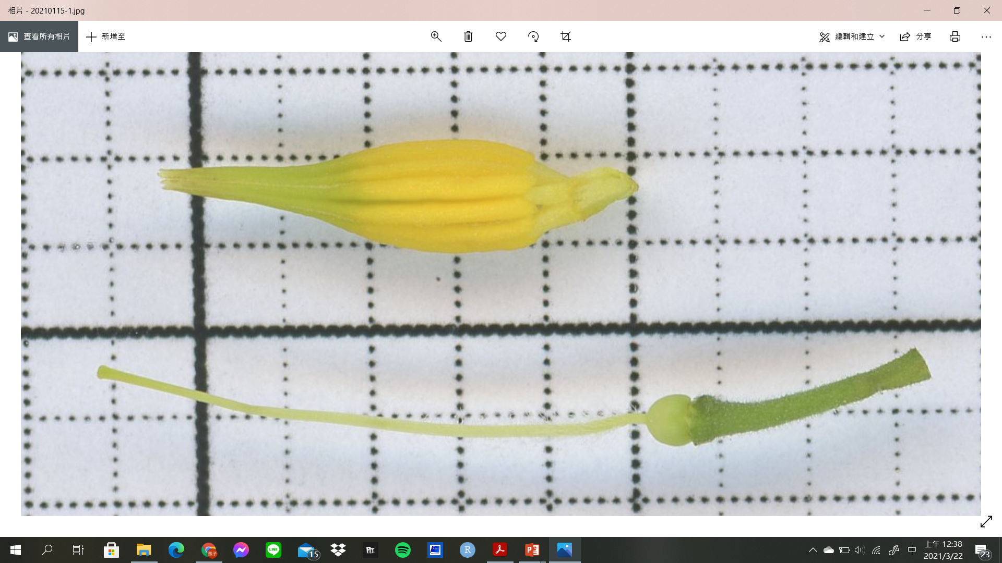
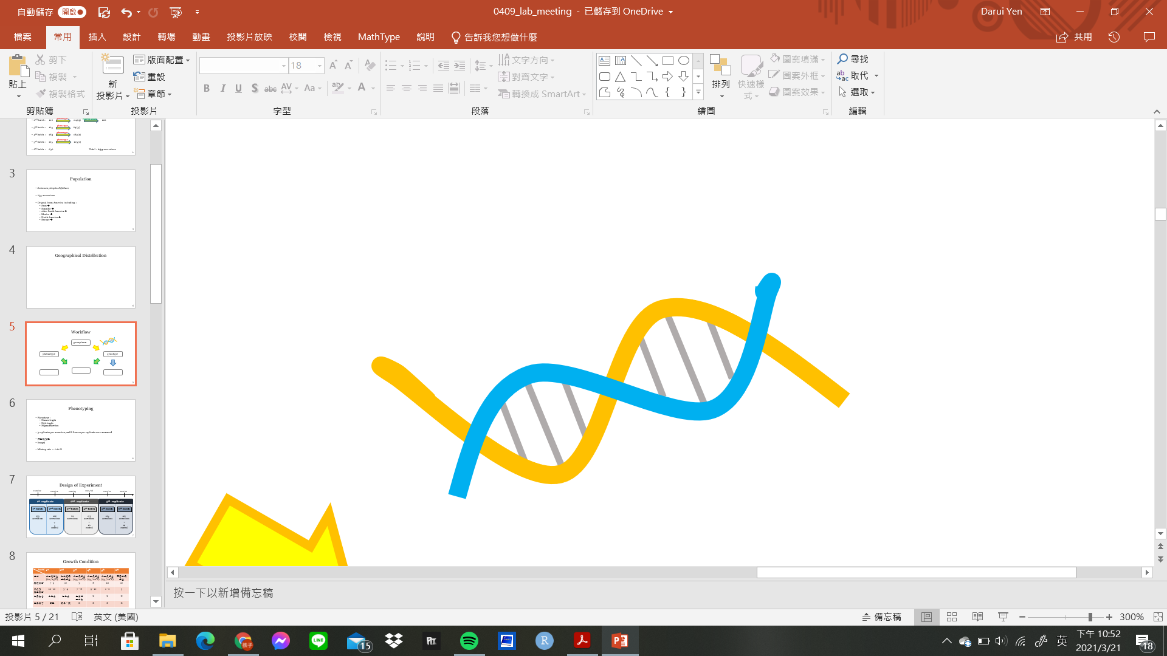
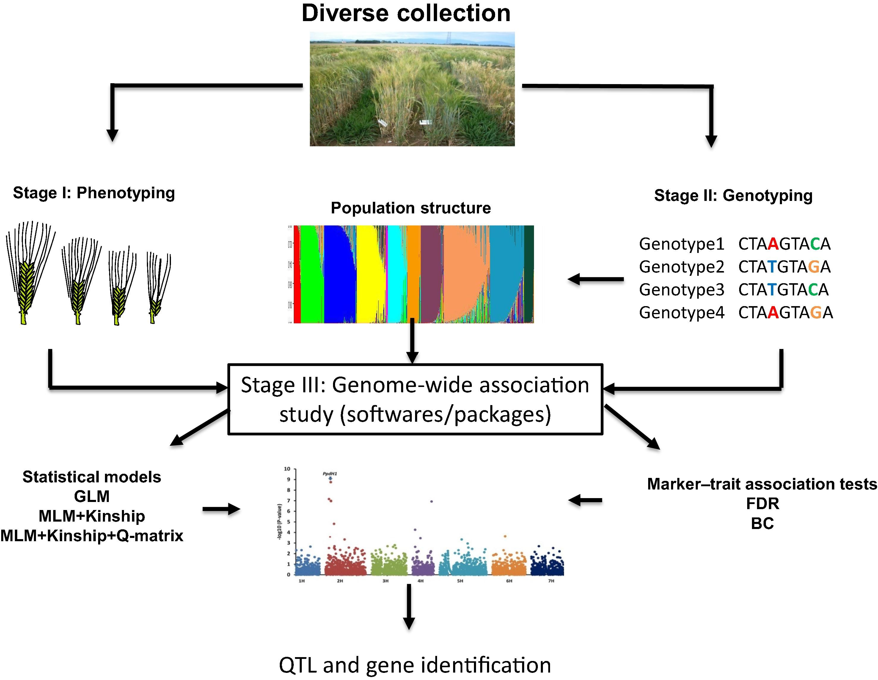
germplasm
phenotype
genotype
population structure
GWAS
geographic distribution

Slide 6
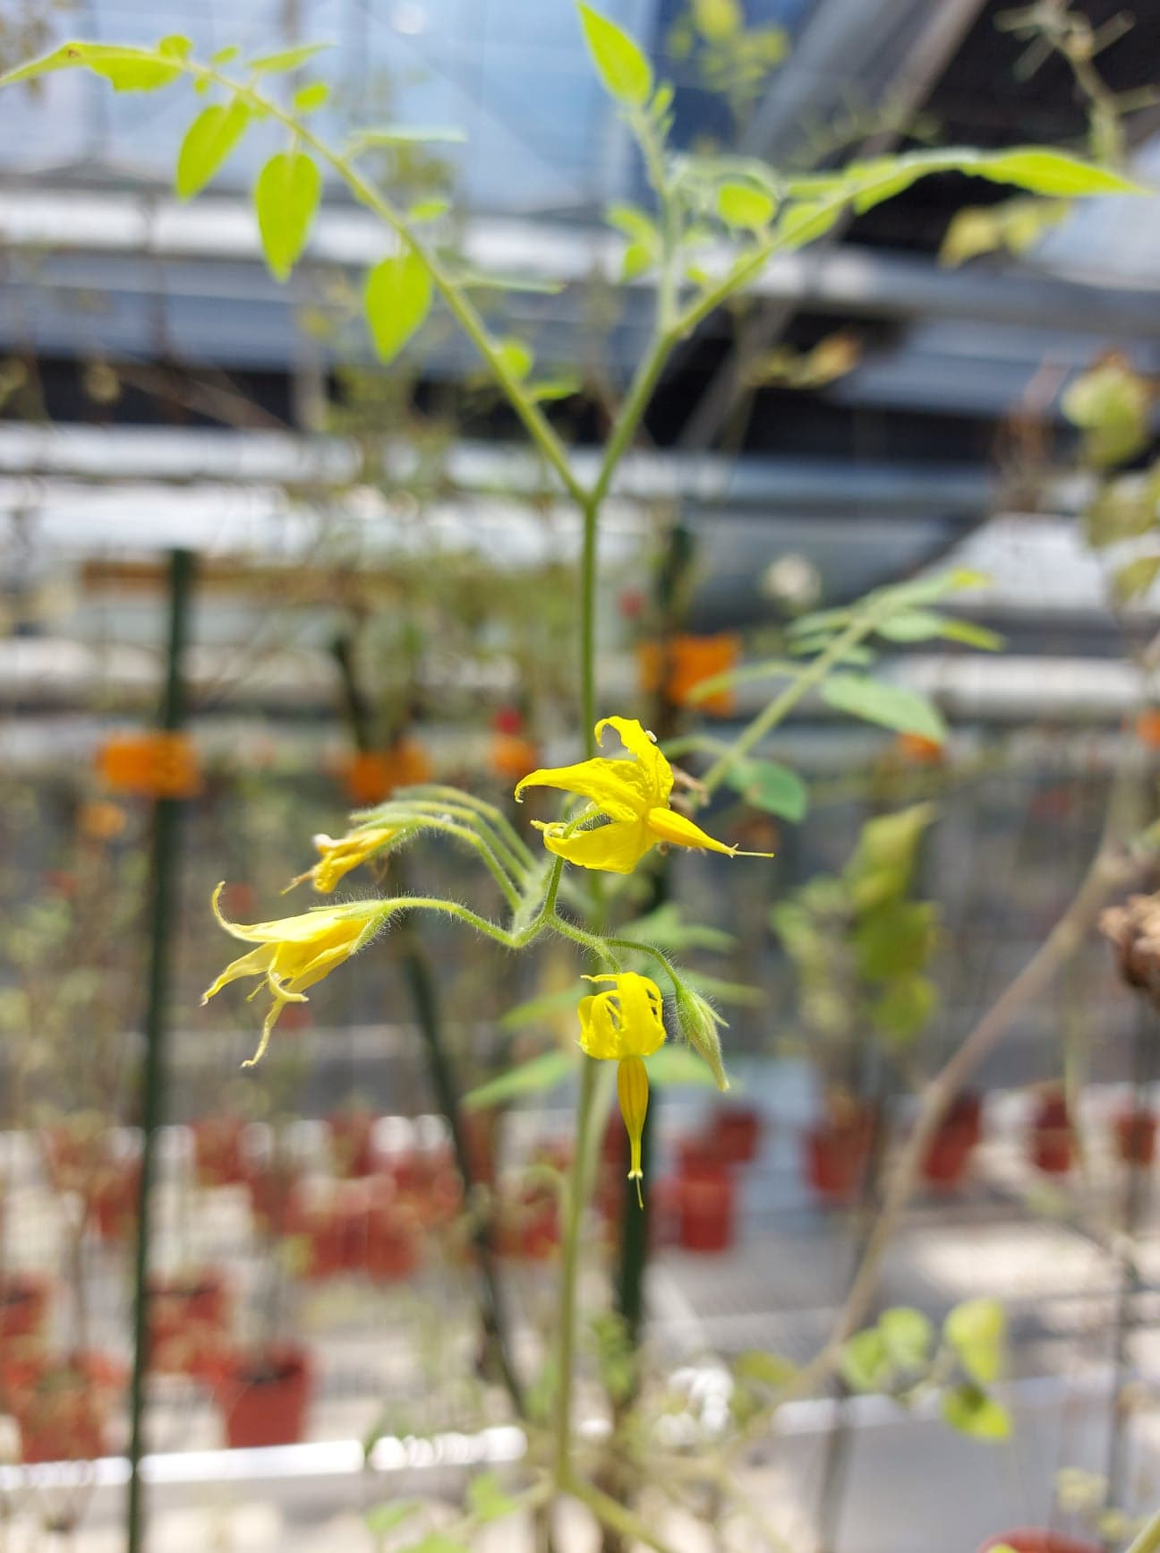
Stigma Exsertion
Level of outcrossing is greatly influence by
flower size
stigma exsertion length
A major QTL se2.1 on chromosome 2
stamen2.1, stamen2.2, stamen2.3
style2.1
dehiscence2.1
(Chen, K. Y., & Tanksley, S. D., 2004)

Slide 7
Phenotyping
Phenotype
stamen length
style length
stigma exsertion
3 replicates per accession
&
8 flowers per replicate
Procedure
Scan the stamens and styles by scanner
Measure the length by ImageJ (1.52 v.)
Missing Rate = 0.49 %

Slide 8
Growth Condition
batch | 1st | 2nd | 3rd | 4th | 5th | 6th
地點 | 人工氣候室 (20 / 15ºC) | 台大農場玻璃溫室 | 人工氣候室 (25 / 20ºC) | 人工氣候室 (25 / 20ºC) | 人工氣候室 (25 / 20ºC) | 園藝分場 溫室
播種月份 | 7 - 9 | 12 | 3 | 8 | 10 | 12
外表型 調查月份 | 10 - 12 | 3 - 4 | 7 – 8 | 9 - 12 | 1 - 2 | 3
主要病害 | 白粉病 | 白粉病 | 細菌性 斑點病 | X | X | X
主要蟲害 | 葉蟎 | 薊馬、蛾 | X | X | X | X

Slide 9
Design of Experiment
2019/07
2019/12
2020/03
2020/08
2020/10
2020/12
1st replicate
2nd replicate
3rd replicate
1st batch
2nd batch
3rd batch
4th batch
5th batch
6th batch
133 accessions
102 accessions
+
9 controls
61 accessions
173 accessions
+
10 controls
125 accessions
107 accessions
+
10 controls

Slide 10
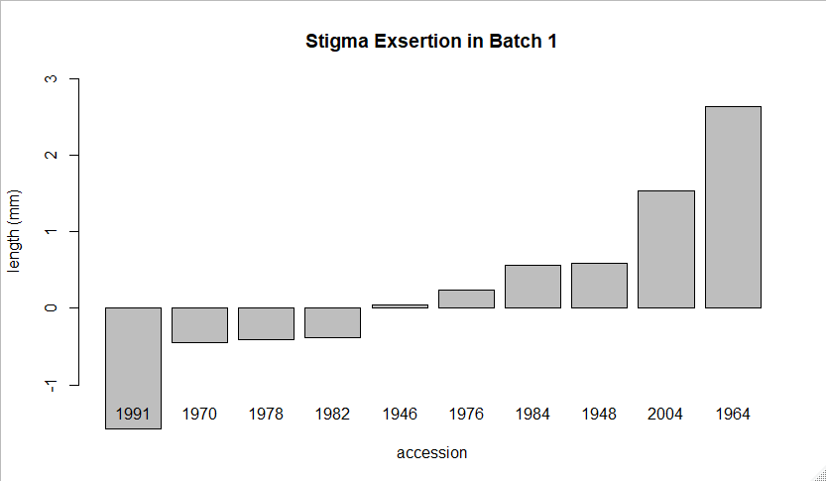
Control Group

Slide 11
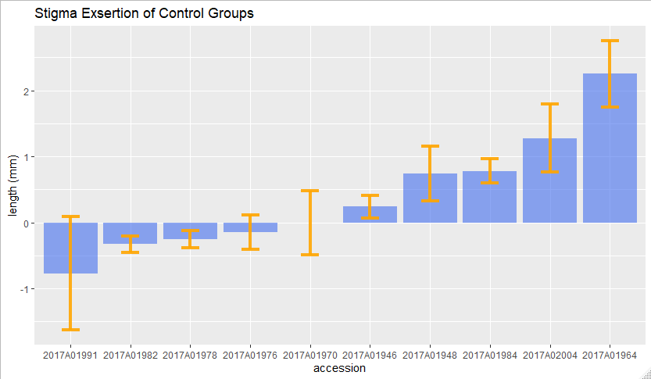
Control Group

Slide 12
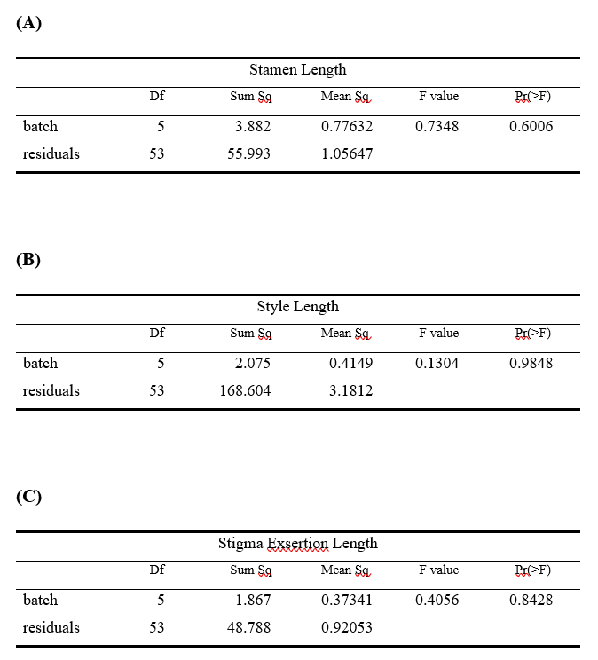
ANOVA for Control Group

Slide 13
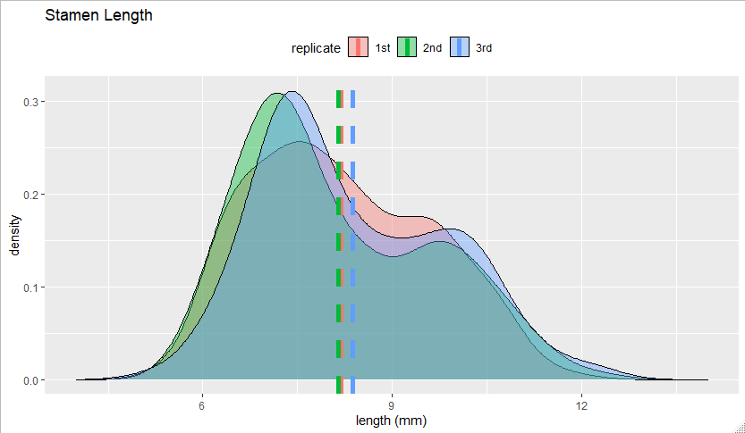
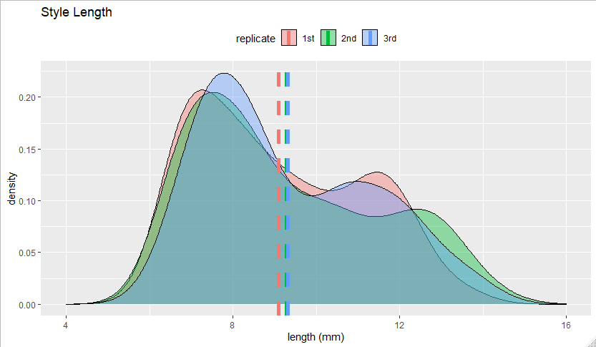
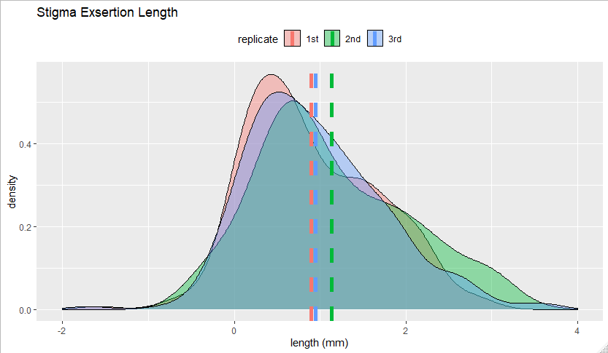
Overall Exsertion Rate = 92.76 %

Slide 14
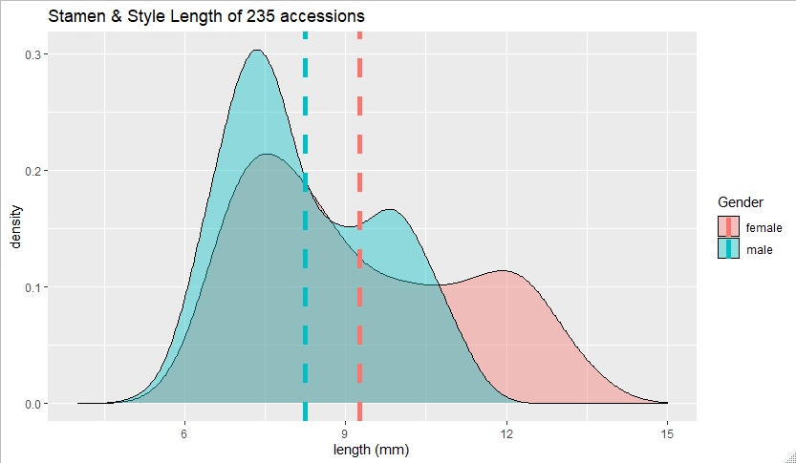
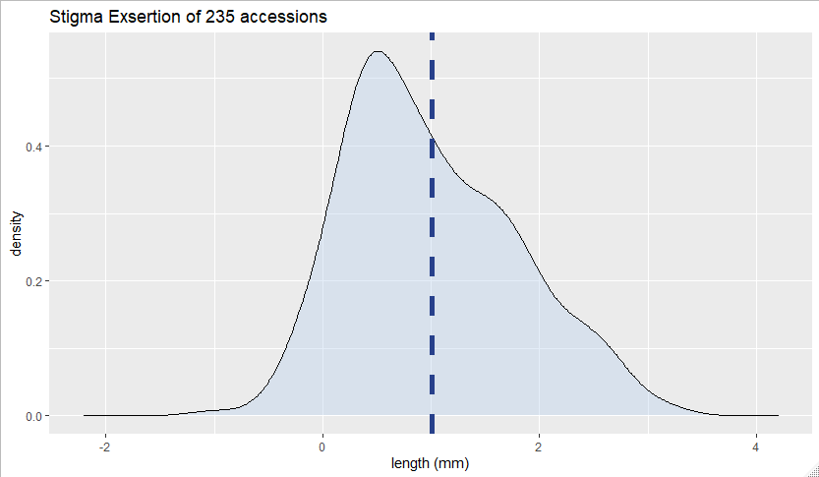
Combine 3 Replicates
Board-sense Heritability = 93% / 90%
Board-sense Heritability = 83.99%

Slide 15
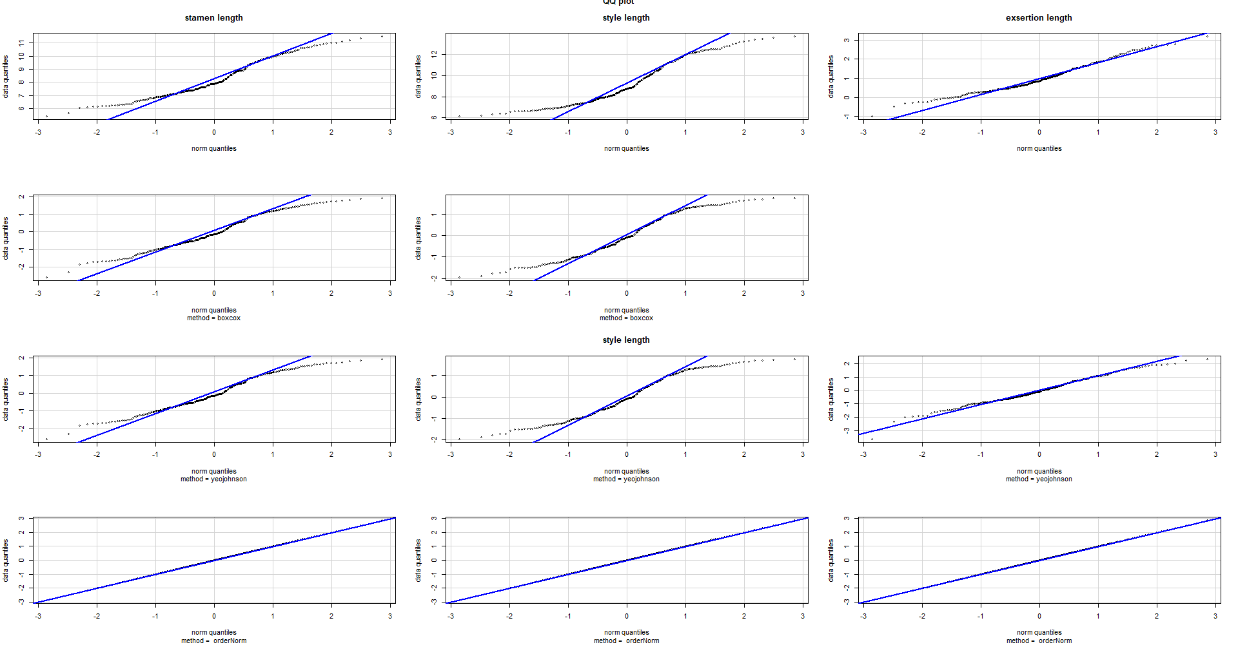

Slide 16
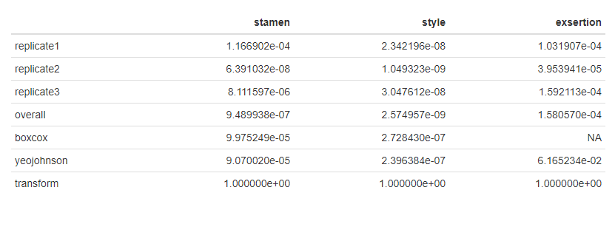
Shapiro-Wilk Test

Slide 17
Transformation on Quantitative Traits
Genotype data was generated from a disease model with 1 causal SNP allele
Effect Size
1%
2%
20%
Sample Size
1000
2000
4000
8000
Quantitative Traits
normal
left-skew
right-skew
bimodal
Transformation
logarithm
inverse-logarithm
Box-Cox
rank-based
Goh, L., & Yap, V. B. (2009). Effects of normalization on quantitative traits in association test. BMC bioinformatics, 10(1), 1-8.

Slide 18
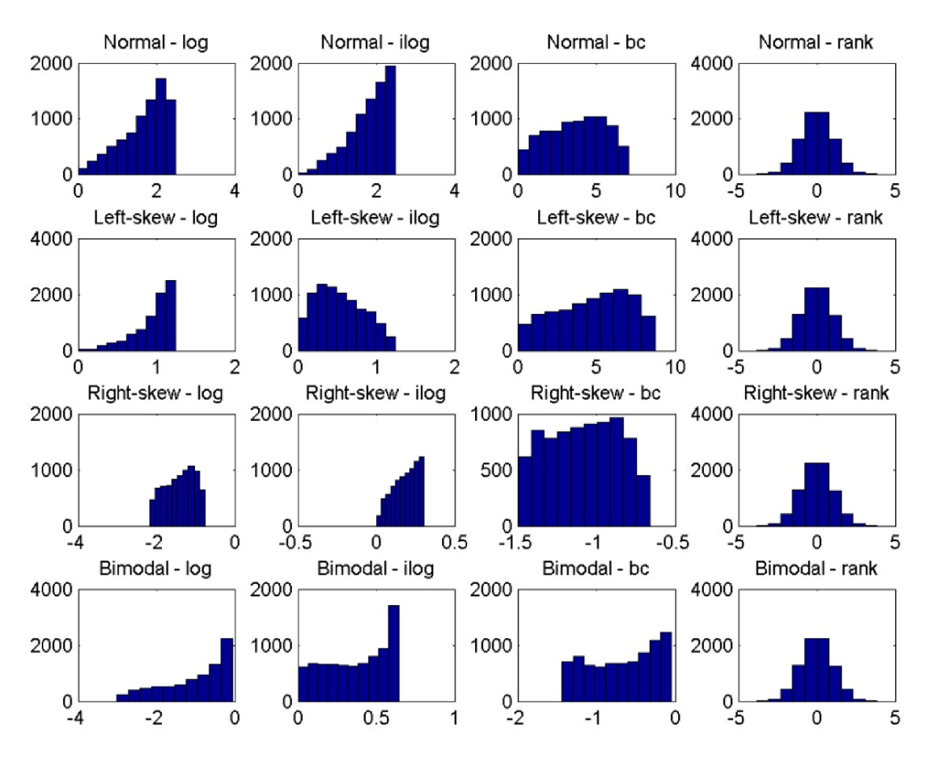
Goh, L., & Yap, V. B. (2009). Effects of normalization on quantitative traits in association test. BMC bioinformatics, 10(1), 1-8.

Slide 19
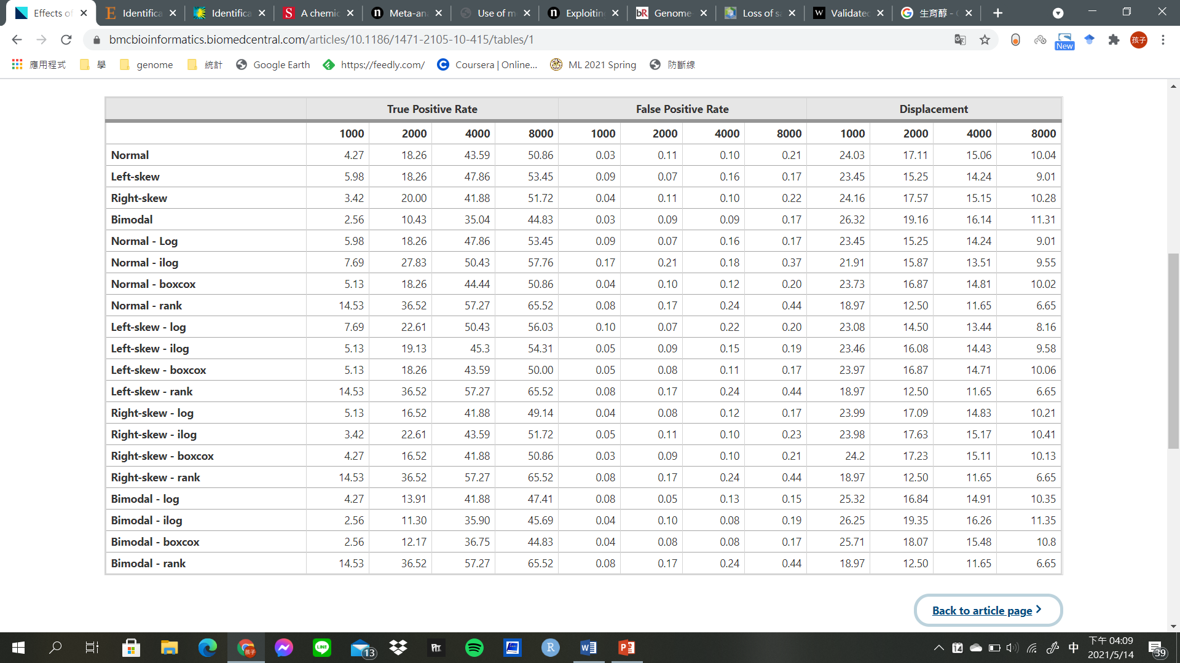
PVE = 0.01
Goh, L., & Yap, V. B. (2009). Effects of normalization on quantitative traits in association test. BMC bioinformatics, 10(1), 1-8.

Slide 20
Simulation Results
It showed improved results with rank-based transformation
Rank-based transformation incurred a slightly higher false positive
Transformation had little effect when the effects and sample size were large
The increase of sensitivity outweighs the slight increase in false positive rate
Goh, L., & Yap, V. B. (2009). Effects of normalization on quantitative traits in association test. BMC bioinformatics, 10(1), 1-8.

Slide 21
Constrains in Parametric Methods
MLM may lead to false negatives by overcompensating for population structure and relatedness
Parametric tests of association are sensitive to SNPs with minor allele frequencies
Most current GWAS methods lack the power to detect rare alleles
Yang, N., Lu, Y., Yang, X., Huang, J., Zhou, Y., Ali, F., ... & Yan, J. (2014). Genome wide association studies using a new nonparametric model reveal the genetic architecture of 17 agronomic traits in an enlarged maize association panel. PLoS genet, 10(9), e1004573.

Slide 22
GWAS for 17 Traits using MLM
It may be too strict to use 0.05/n as the cutoff since not all the markers are independent
Yang, N., Lu, Y., Yang, X., Huang, J., Zhou, Y., Ali, F., ... & Yan, J. (2014). Genome wide association studies using a new nonparametric model reveal the genetic architecture of 17 agronomic traits in an enlarged maize association panel. PLoS genet, 10(9), e1004573.

Slide 23
Anderson-Darling (AD) Test
affect flowering time
photoperiod regulatory gene
regulating flowering time
days to heading
affecting flowering time
Yang, N., Lu, Y., Yang, X., Huang, J., Zhou, Y., Ali, F., ... & Yan, J. (2014). Genome wide association studies using a new nonparametric model reveal the genetic architecture of 17 agronomic traits in an enlarged maize association panel. PLoS genet, 10(9), e1004573.
Notes:
AD test Introduction

Slide 24
Shortcoming of AD Test
A reasonable number of spurious associations should be existed in the detected loci
Population structure is not properly addressed in each subpopulation
Genomic control is a popular method to control the population stratification
Yang, N., Lu, Y., Yang, X., Huang, J., Zhou, Y., Ali, F., ... & Yan, J. (2014). Genome wide association studies using a new nonparametric model reveal the genetic architecture of 17 agronomic traits in an enlarged maize association panel. PLoS genet, 10(9), e1004573.

Slide 25
3 Scenarios of Simulation
main factors
allele frequency
trait distribution
scenarios
normal distribution
abnormal distribution caused by uncertain effectors
abnormal distribution caused by large effect QTN with rare alleles
models
A-D test
K-W test
LM
MLM
Yang, N., Lu, Y., Yang, X., Huang, J., Zhou, Y., Ali, F., ... & Yan, J. (2014). Genome wide association studies using a new nonparametric model reveal the genetic architecture of 17 agronomic traits in an enlarged maize association panel. PLoS genet, 10(9), e1004573.

Slide 26
normal
uncertainty
random QTN
major QTNs
common allele frequency
schemes 1 & 3 & major QTNs ➔ MLM≥NP
scheme 2 ➔ NP>P
moderate QTNs ➔ NP>P
rare alleles ➔ AD>KW ≥ MLM
moderate QTNs
common allele frequency
major QTNs
rare allele frequency
moderate QTNs
rare allele frequency
(Yang et al., 2014)

Slide 27
Discussion of Nonparametric Method
Nonparametric methods usually have greater power than MLM for
abnormal phenotypes
rare alleles
moderate QTN
A-D test didn't account for population structure
A-D test could be a good complement to current popular GWAS methods
Yang, N., Lu, Y., Yang, X., Huang, J., Zhou, Y., Ali, F., ... & Yan, J. (2014). Genome wide association studies using a new nonparametric model reveal the genetic architecture of 17 agronomic traits in an enlarged maize association panel. PLoS genet, 10(9), e1004573.

Slide 28
Conclusion
235 S. pimpinellifolium accessions original from America were collected
Most accessions showed varying degrees of stigma exsertion
The stigma length & style length appeared in bimodal pattern
Both quantile transformation & nonparametric GWAS can increase the power of test

Slide 29
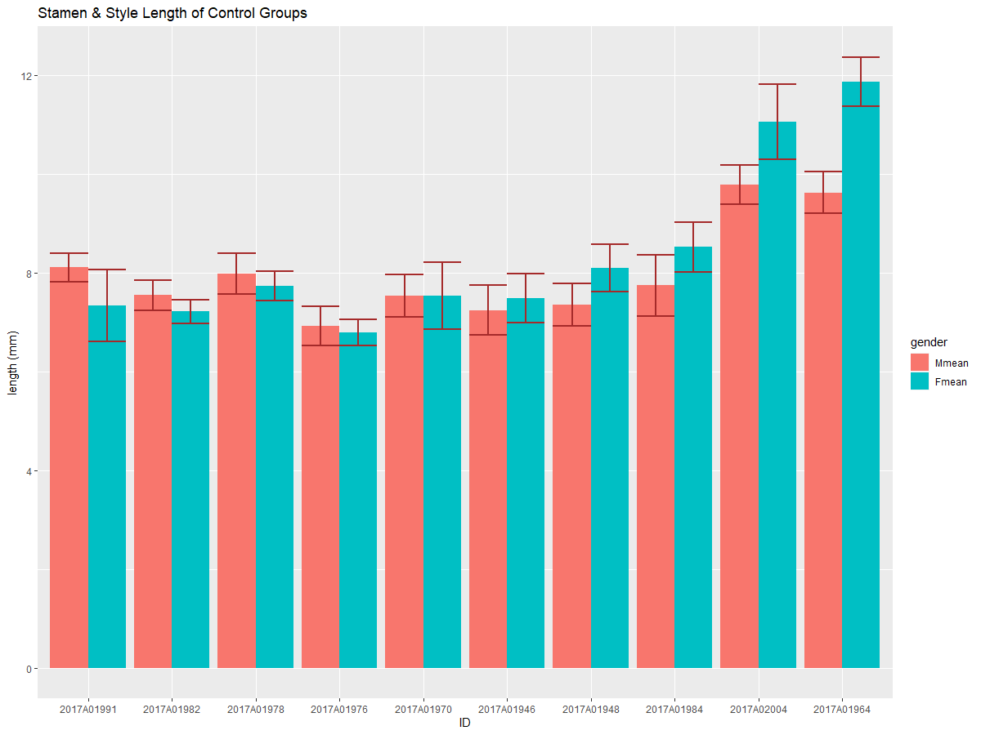
Control Group

Slide 30
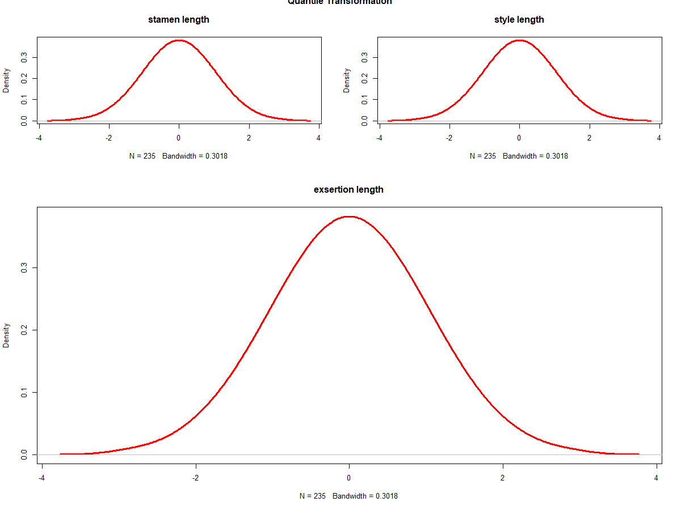
Quantile Transformation

Slide 31
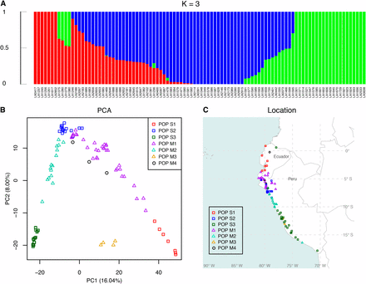
Population Structure
Lin, Y. P., Liu, C. Y., & Chen, K. Y. (2019). Assessment of genetic differentiation and linkage disequilibrium in Solanum pimpinellifolium using genome-wide high-density SNP markers. G3: Genes, Genomes, Genetics, 9(5), 1497-1505.

Slide 32
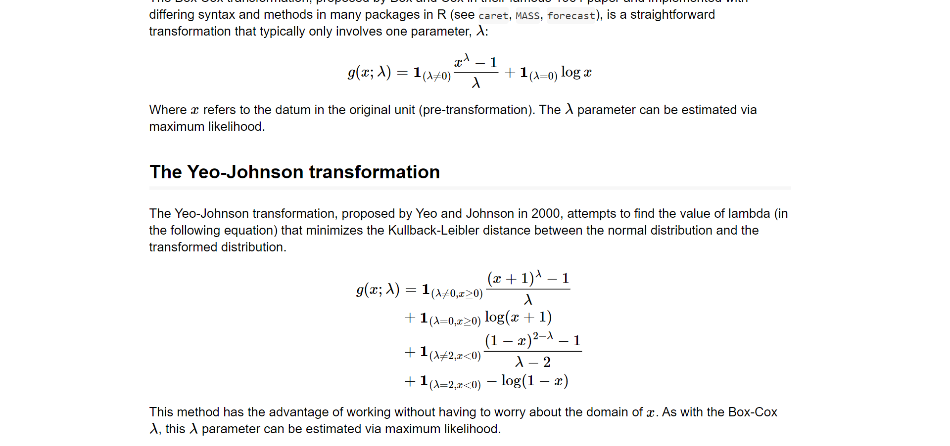
Box-Cox & Yeo-Johnson

Slide 33
PVE = 0.01
Goh, L., & Yap, V. B. (2009). Effects of normalization on quantitative traits in association test. BMC bioinformatics, 10(1), 1-8.

Slide 34
Scheme 1
Total phenotypic variation : 100%
epistatic genetic effect : 10%
population structure : 10%
residual effect : 10%
addictive genetic effect : 70%
4 major QTNs : 21%
16 moderate QTNs : 49%
Half are rare alleles : MAF = 0.05 - 0.1
Others are common alleles : MAF = 0.25 – 0.45

Slide 35
Scheme 2 & 3
Scheme 2 :
10% of lines were randomly selected and added an extra residual effect
Scheme 3 :
addictive genetic effect : 70%
1 background QTN : 17.5%
3 major QTNs : 14%
16 moderate QTNs :

Slide 36
Solanum pimpinellifolium is one of the closest wild relative of tomato cultivar, and provided valuable genetic resources in modern tomato breeding.
In our study, 235 S. pimpinellifolium germplasm were collected, and the stigma length and style length were investigated.
The result indicated that the population not only showed extremely high stigma exsertion rate, but also were with varying degrees of exsertion length.
Unfortunately , the phenotype in our study appeared in bimodal pattern, which may not be appropriate to perform genome-wide association study without any further data preprocessing.
After reviewing two literatures, we learned that both quantile transformation and nonparametric GWAS can increase the power of test, but simultaneously pay the price of slightly higher false positive rate.

